Slide 1

Flask Project
Event Manager
GitHub
Site

Slide 2

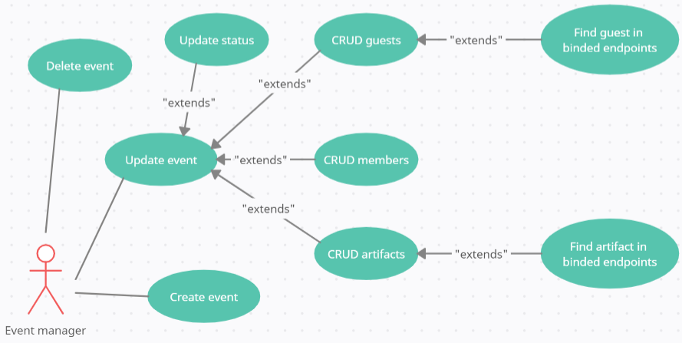
— one Use Case extends another Use Case
CRUD — ability to Create, Read, Update, Delete
UseCase diagram

Slide 3
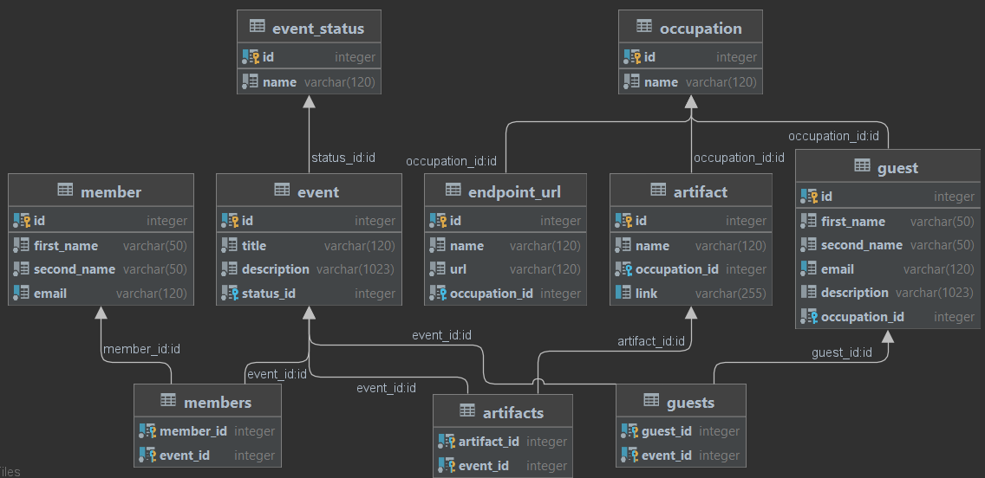
Database diagram

Slide 4
Stack of technologies
Flask 2.0.1 | Flask provides you with tools, libraries and technologies that allow you to build a web application.
PostgreSQL 13.4 | PostgreSQL have many features aimed to help developers build applications, administrators to protect data integrity and build fault-tolerant environments, and help you manage your data.
Flask SQLalchemy 2.5.1 | Flask-SQLAlchemy is an extension for Flask that aims to simplify using SQLAlchemy with Flask by providing defaults and helpers to accomplish common tasks.
Flask Marshmallow 0.14.0 | Flask Marshmallow helps with validate input data, deserialize input data to app-level objects, serialize app-level objects to primitive Python types.
Flask RESTful 0.3.9 | Flask-RESTful is a simple, easy to use Flask extension that helps you construct APIs. It gives you a clean interface for easily parsing arguments to your resources.

Slide 5
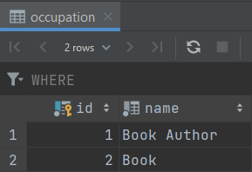
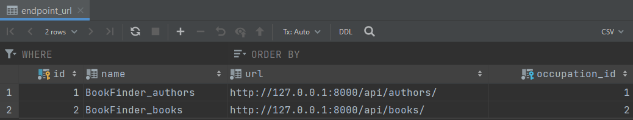
Endpoints url by occupation

Slide 6
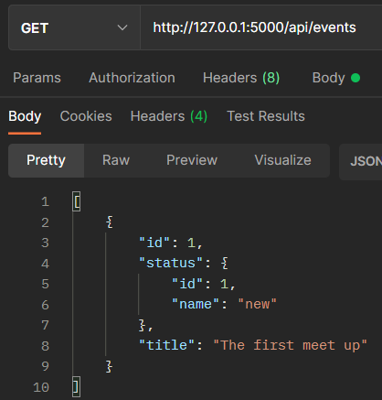
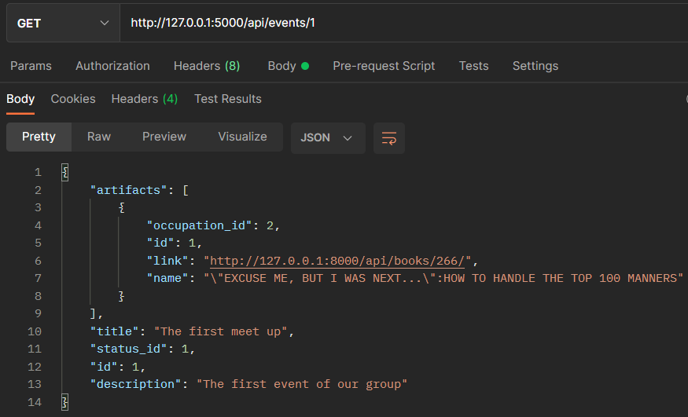
Endpoints for list of events and detail of event

Slide 7
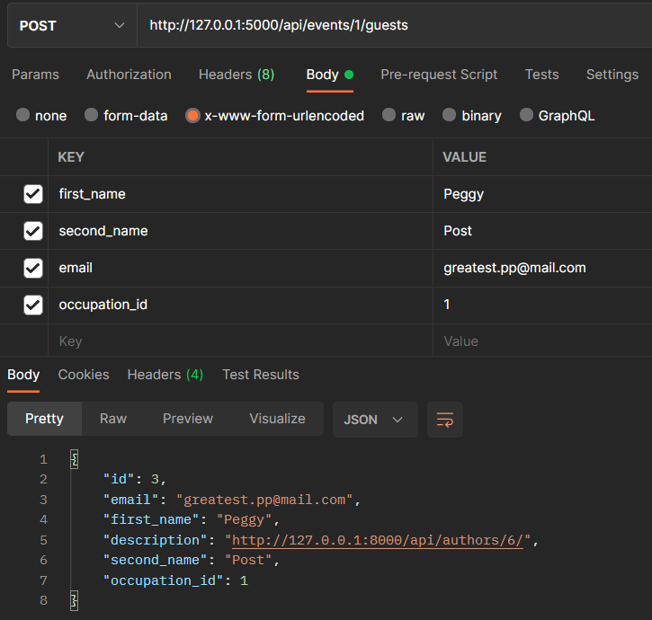
Creating a new guest for event and automatic link on endpoint description

Slide 8
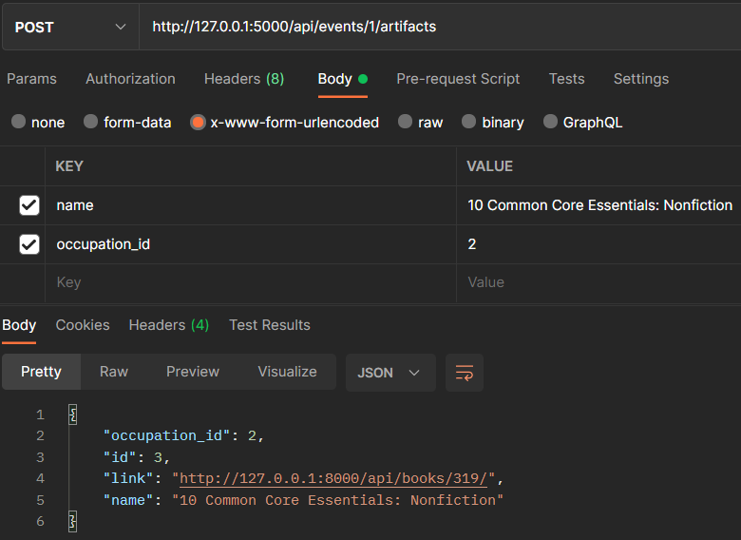
Creating a new artifact for event and automatic link on endpoint of artifact

Slide 9
Thank you
for the attention!
Now - Demo

